Slide 1
Weakly Supervised Instance Segmentation
Meng Dong
2019.5.10

Slide 2
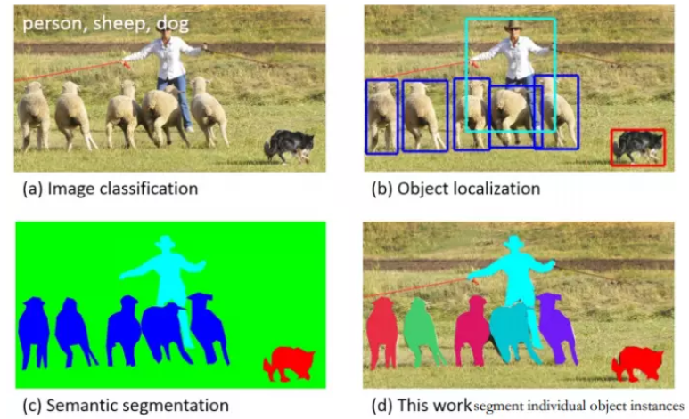
Semantic Segmentation v.s. instance Segmentation

Slide 3
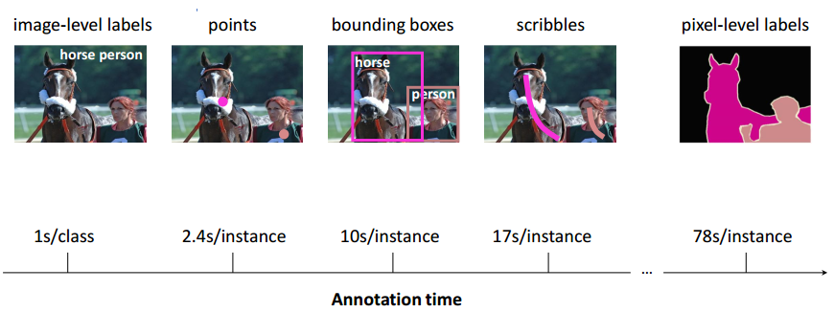
Manual annotations for object recognition

Slide 4
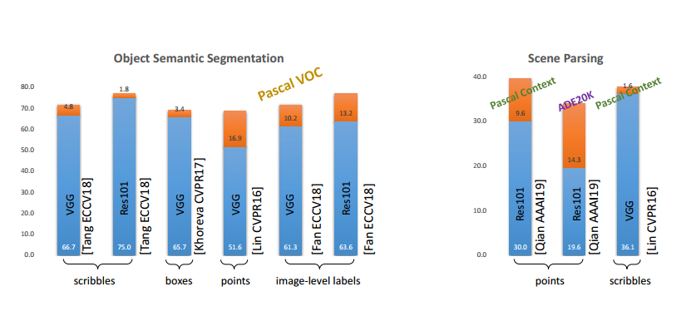
Current State-of-the-arts

Slide 5
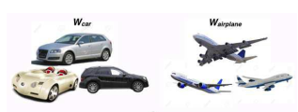
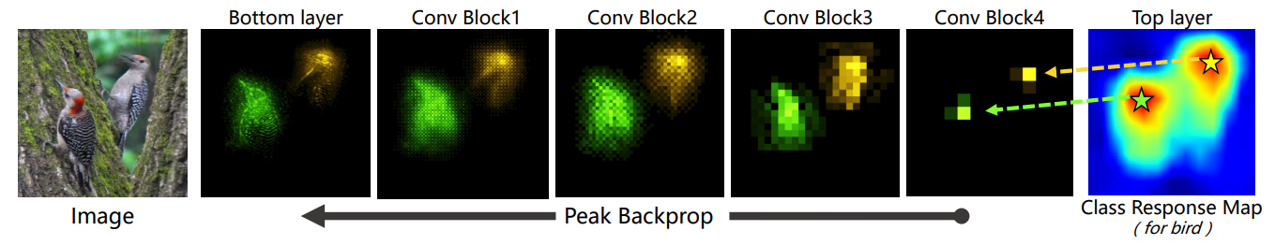
Methods – learning to produce pseudo pixel-level masks
Additional data
Object proposal
Proposals aggregation
Graph cut inside proposals
Top-down attention

Slide 6
Two papers
Weakly Supervised Instance Segmentation using Class Peak Response
Object Counting and Instance Segmentation with Image-level Supervision

Slide 7
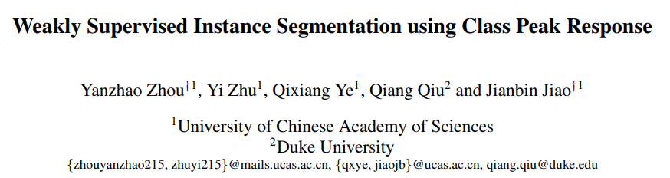

Slide 8
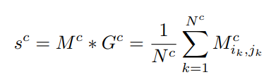

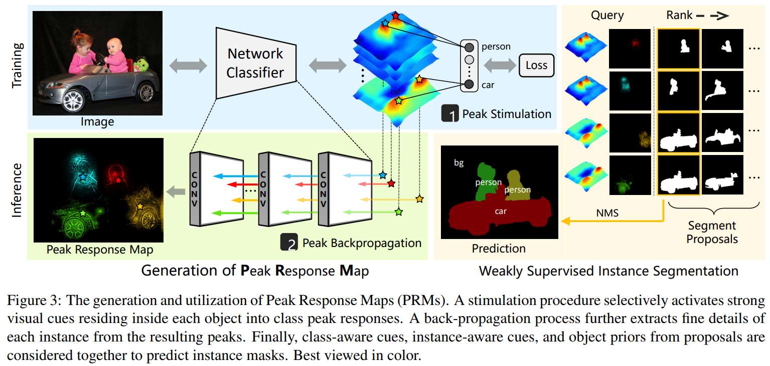
Framework
Class activity map

Slide 9
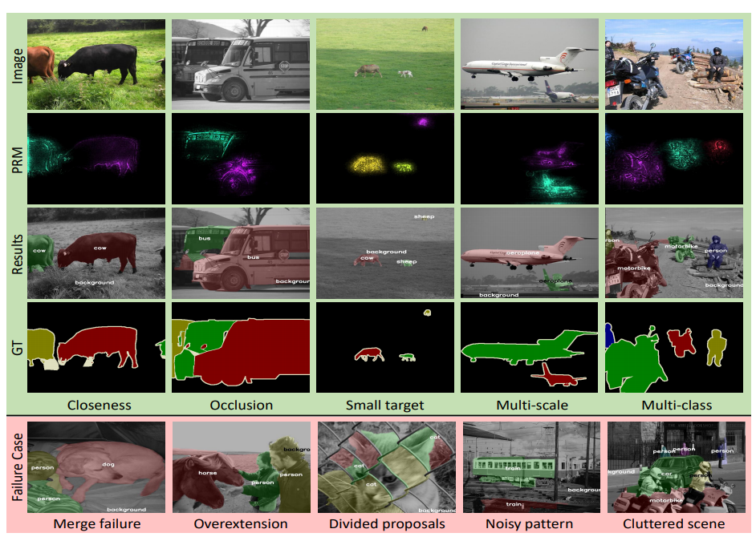
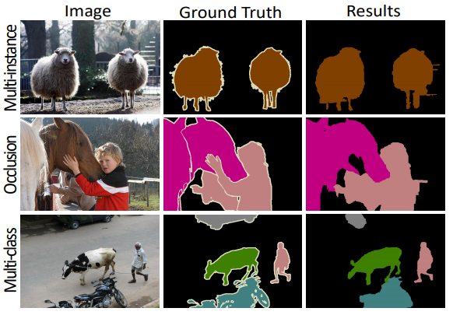
Visualization results

Slide 10
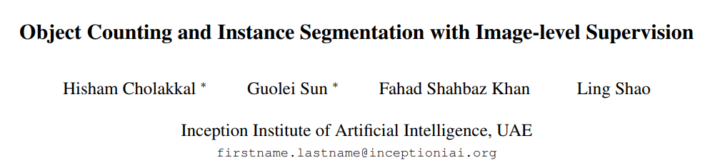
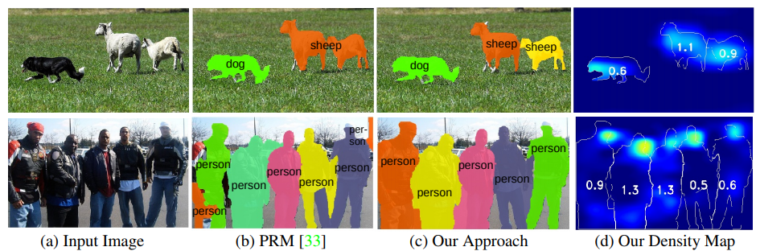

Slide 11
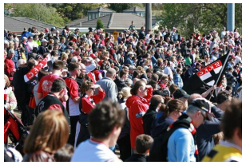
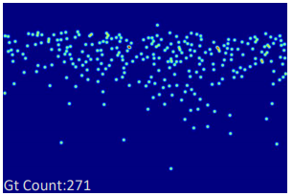
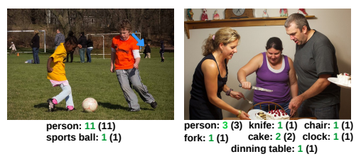
Some conceptions
Crowd counting
Counting in this paper
Subitizing range (1~4)
Annotations: image-level classification & subitizing range number
ILC: image-level lower-count supervision
How many people in the picture?
Regression
Localization-based
(density map)
Two methods

Slide 12

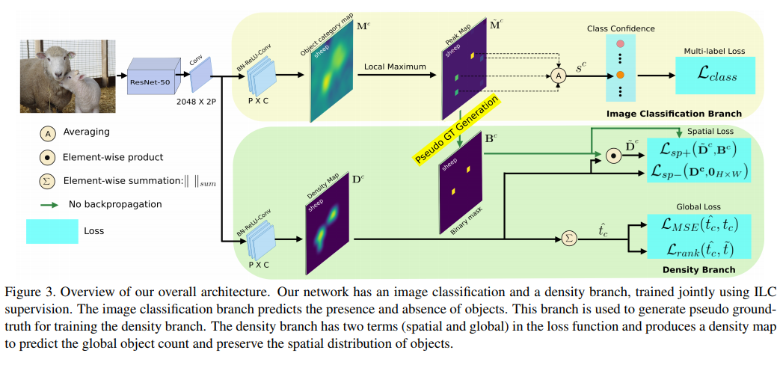




Framework
Classification branch
multi-label soft-margin loss
2. Density map branch
Class activity map
Density map

Slide 13
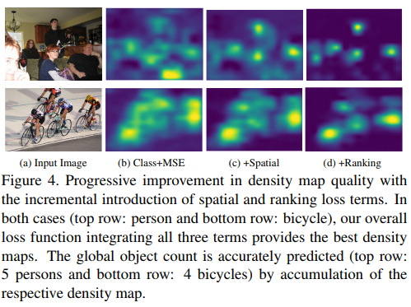
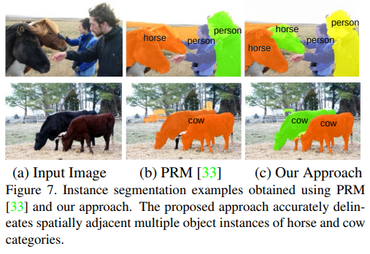
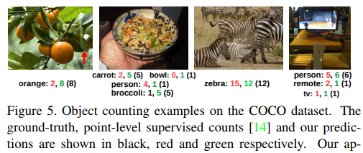
Visualization results

Slide 14
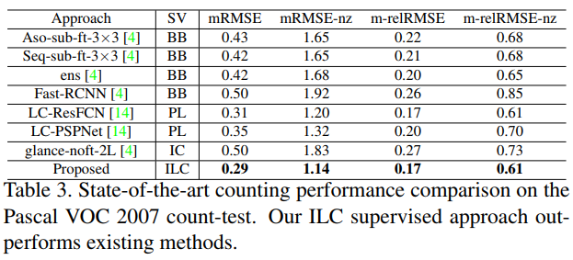
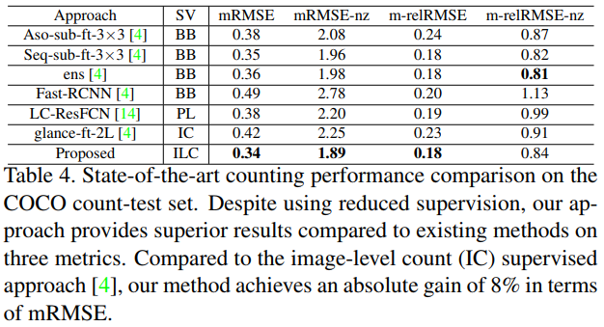
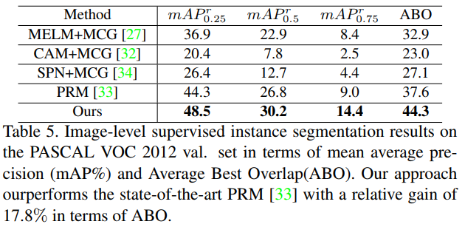
State-of-the-art Comparison

Slide 15
Thank you!

